Slide 1
CTSU Regulatory Office Overview
Version 2.0 February, 2023

Slide 2
General
Coalition of Cancer Cooperative Groups in Philadelphia, PA
Centralized repository for the regulatory documents for NCI-supported cancer clinical trials
Streamlines and comprehensive approach to collecting and maintaining documentation essential to the management of clinical trials

Slide 3
Protocol Setup

Slide 4
Lead Protocol Organizations (LPOs)
National Clinical Trials Network (NCTN)
Experimental Therapeutics Clinical Trials Network (ETCTN)
Other Networks
Alliance
CCTG
COG (Pediatric)
ECOG-ACRIN
NRG Oncology
SWOG
Lead Academic Organizations (LAO)
NCI Early Drug Development Opportunity Program (EDDOP)
Cancer Center Research Bases (CCRBs)
PBTC
Wake Forest
And more!

Slide 5
Protocol Setup
The CTSU acts as the designee(s) for the LPO for all protocol setup responsibilities
To facilitate quick and accurate protocol setup requests, LPOs are encouraged to use the CTSURegSetup@coccg.org email address
At the time of protocol development, the LPO determines the list of protocol-specific documents required prior to patient enrollment

Slide 6
Protocol Setup – Data Input
Data Uploaded by PIO’s START
Protocol Title & Number
Phase of Trial (I, II, III)
Name of the LPO
Protocol status with the LPO
CTEP Study agents
CIRB reviewed
Study Participants
PIO Version information
Registration Types of OPEN Investigators and other tasks
Data Uploaded by CTSU
Version Data:
Review Type, Due Date, Collection Status
Participating countries
Investigational New Drug (IND) type
Collection of IRB approval post closure
Registration steps
OPEN person types
Status of CTSU website posting
Use of CTSU’s Online Patient Enrollment Network (OPEN), Rave, or Transfer of Images and Data (TRIAD) systems

Slide 7
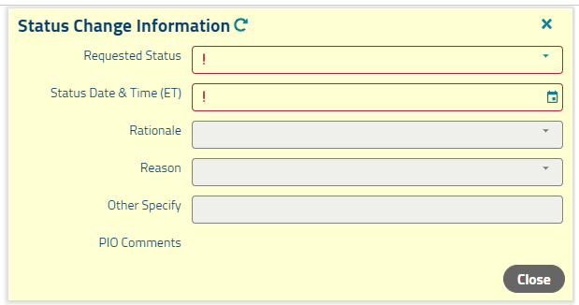
Status Change Requests
The LPOs submit status change requests to PIO from within the RSS

Slide 8
Regulatory Submission

Slide 9
Submitting Regulatory Documentation
Documentation is uploaded via the Regulatory Submission Portal located on the CTSU website under the Regulatory Tab
Local clinical site personnel, LPOs, and outside entities send regulatory documents to the CTSU via the Regulatory Submission Portal
Original ink-signed documentation can be mailed
All Portal submissions are issued a:
Packet ID
Tracking Code
Can track status of submissions using Packet ID and/or Tracking Code

Slide 10
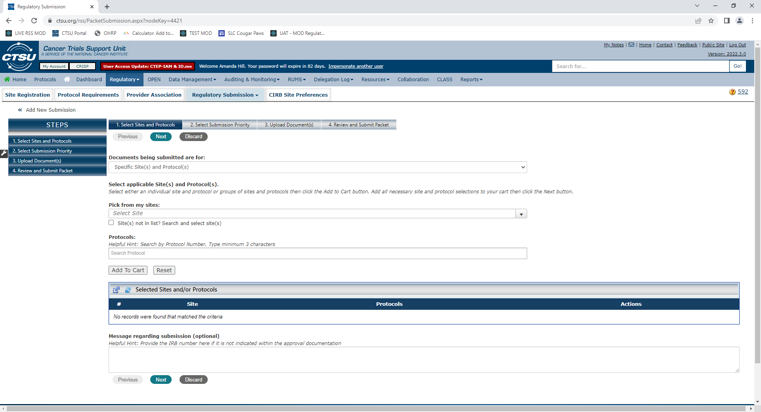
Regulatory Submission Portal – Uploads

Slide 11
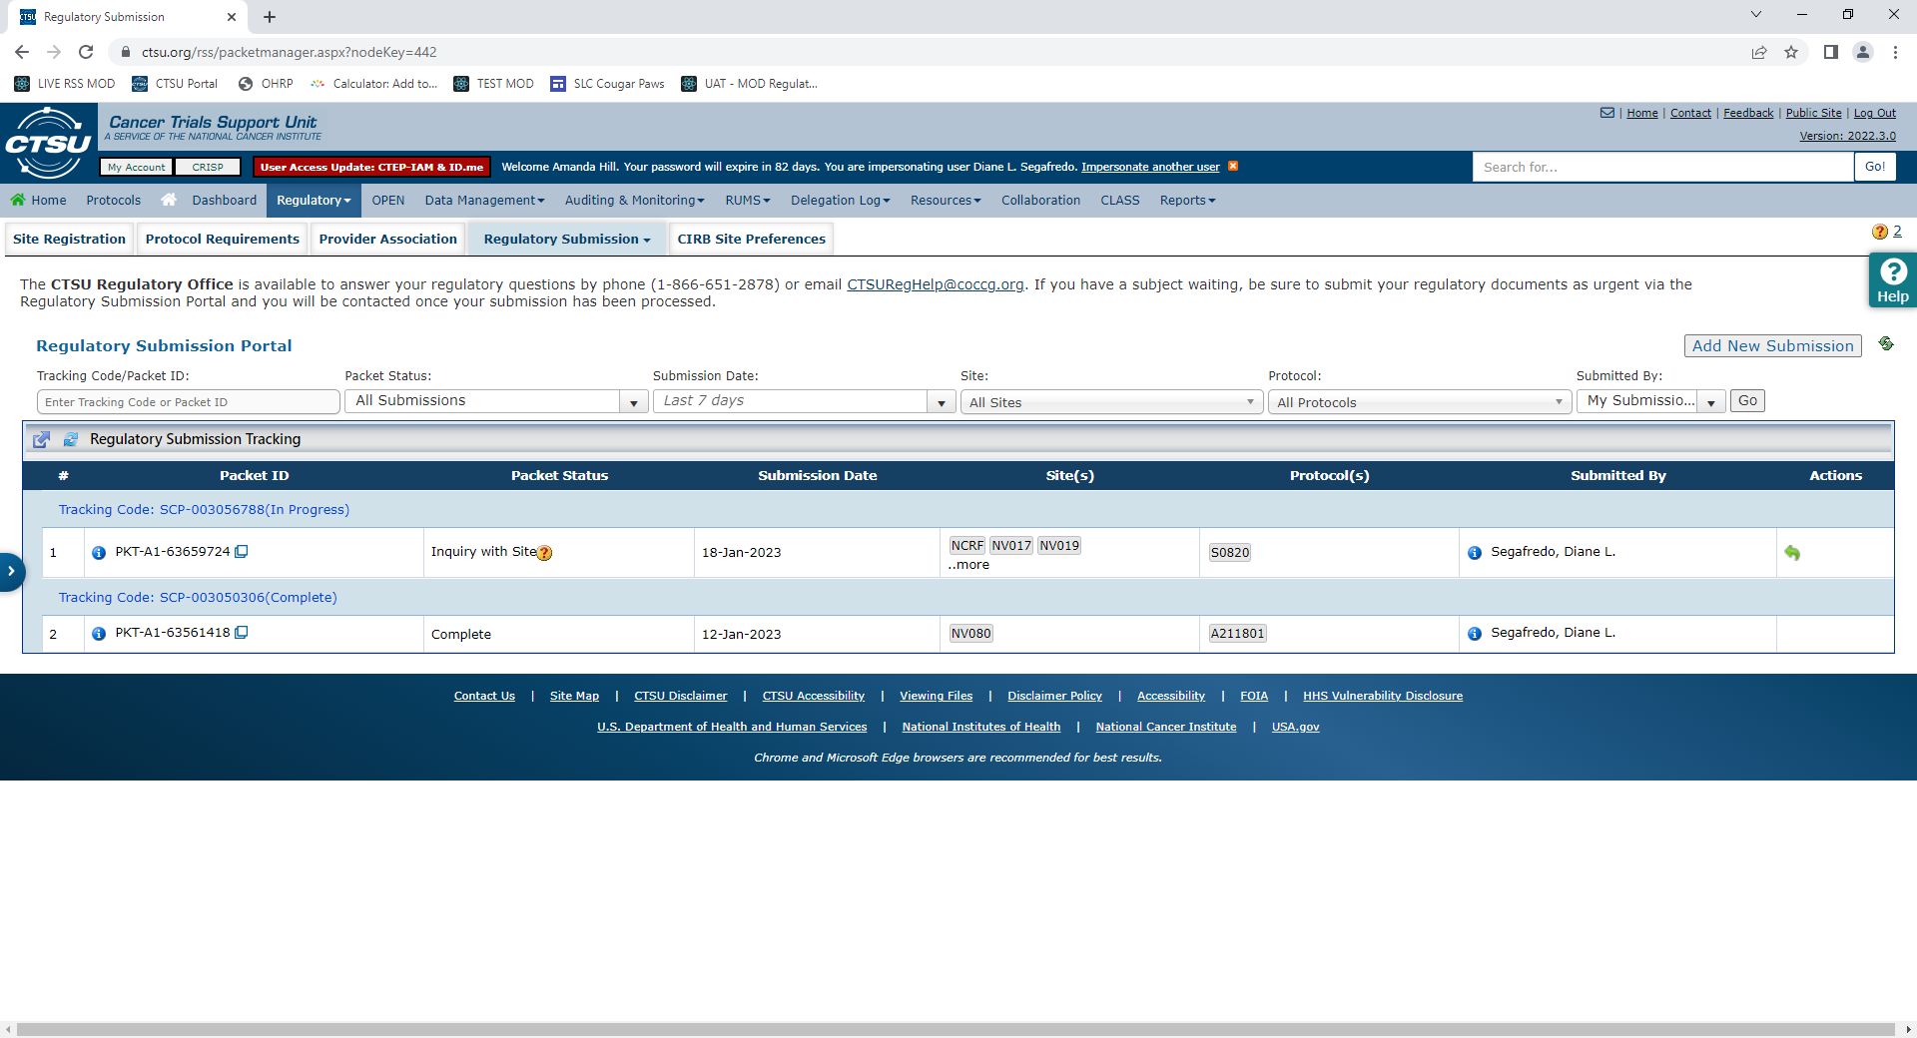
Regulatory Submission Portal – Packet Tracking

Slide 12
Processing Time
CTSU asks that institutions allow 1 business day for non-urgent regulatory documents to be processed in the RSS
A regulatory submission is considered urgent if an institution has a patient to enroll within the next 3 days and their site registration status in the RSS is Pending
Sites can note the urgency of a submission in Step 2 on the Regulatory Submission Portal
Sites may contact the Regulatory Office to upgrade a “Normal” submission to “Urgent” if a patient is identified for enrollment

Slide 13
Regulatory Collection

Slide 14
NIH Single IRB Policy
All US sites opening CIRB-reviewed studies on or after 03/01/2019 must utilize the NCI CIRB as their IRB of record
In order for a US site to participate on any NCI-funded clinical trial they must be active on the NCI CIRB roster
Use the CTSU’s Roster Update Management System (RUMS) to request roster changes

Slide 15
Regulatory Collection
The CTSU collects IRB approvals from both local IRBs and the NCI CIRB
Local IRB Approvals are submitted to the CTSU by the participating site via the Regulatory Submission Portal
CIRB Approvals are submitted to the CTSU by the NCI CIRB via a dedicated web-service between CIRB’s IRB Manager system and the CTSU’s RSS
Additional PSRs are submitted to the CTSU by the appropriate user via the Regulatory Submission Portal

Slide 16
IRB Approvals Collected
IRB approvals collected:
Initial
Amendment
Continuing Review
Addition of New Study Location
Principal Investigator Change
Closure
IRB Transfer

Slide 17
IRB Approval Data Points
IRB approval documentation must include:
Protocol Number and Title
Protocol Version Date
PI
Approval Type
Review Type (full board or expedited)
Approval Period
IRB Number

Slide 18
CIRB Processing
Sites participating in a study via the NCI CIRB must have CIRB site preference data established for their CIRB Signatory site
CTSU is responsible for maintaining CIRB site preference data on the CTSU website
Sites are encouraged to utilize the CTSURegPref@coccg.org email address for all CIRB site preference inquiries
Additional information about Site Preference settings is available on the CTSU members website:
https://www.ctsu.org/master/simplepage.aspx?ckey=SITE-PREFERENCE

Slide 19
Additional PSRs
In the RSS, the CTSU tracks a multitude of regulatory requirements ranging from, but not limited to:
Informed Consent Forms
Radiation or imaging credentialing
Surgeon credentialing
Protocol-specific training
Delegation of Tasks Log (DTL)
International site requirements
And many more!

Slide 20
Submission Inquiries
Site Follow-Up
If the CTSU has any issues or questions regarding the submission, the CTSU contacts the submitter directly via an email from the RSS or a phone call
Institutions can respond to CTSU inquiries via the Regulatory Submission Portal. Information provided on the phone will still need to be confirmed via a Portal response

Slide 21
Site Registration Records (1)
Assignment of site registration status uses the extensive data in the RSS to make a determination of whether a site has fulfilled all regulatory criteria:
An active Federalwide Assurance (FWA) Number
An active roster affiliation with the Lead Network or a Participating Organization (PO) and the CIRB (for US sites only)
A valid IRB approval
Compliance with all PSRs
The Site-Protocol PI on the IRB Approval has met all PI validations

Slide 22
Site Registration Records (2)
Site Registration Statuses:
Pending – Site has not fulfilled all study requirements or PI does not meet all validations
Approved – Site has fulfilled all study requirements and may enroll patients
Disapproved – Site is not eligible to participate in the study
Closed – Protocol is no longer open to new patient accrual
Withdrawn – Site has ended their participation in the study
At the time of enrollment, OPEN can utilize the status of certain regulatory requirements in the RSS as well as person or institution credentialing to collect additional information for a site’s patient enrollment(s)

Slide 23
Site-Protocol PI Validations
Active status with CTEP;
Registration type of Investigator (IVR) or Non-physician Investigator (NPIVR), as allowed per protocol:
IRB number on the IRB approval listed in the PI’s Registration and Credential Repository (RCR) profile;
Active status on a participating roster of the site on the IRB approval; and
Practice site on the IRB approval listed on the PI’s RCR profile.

Slide 24
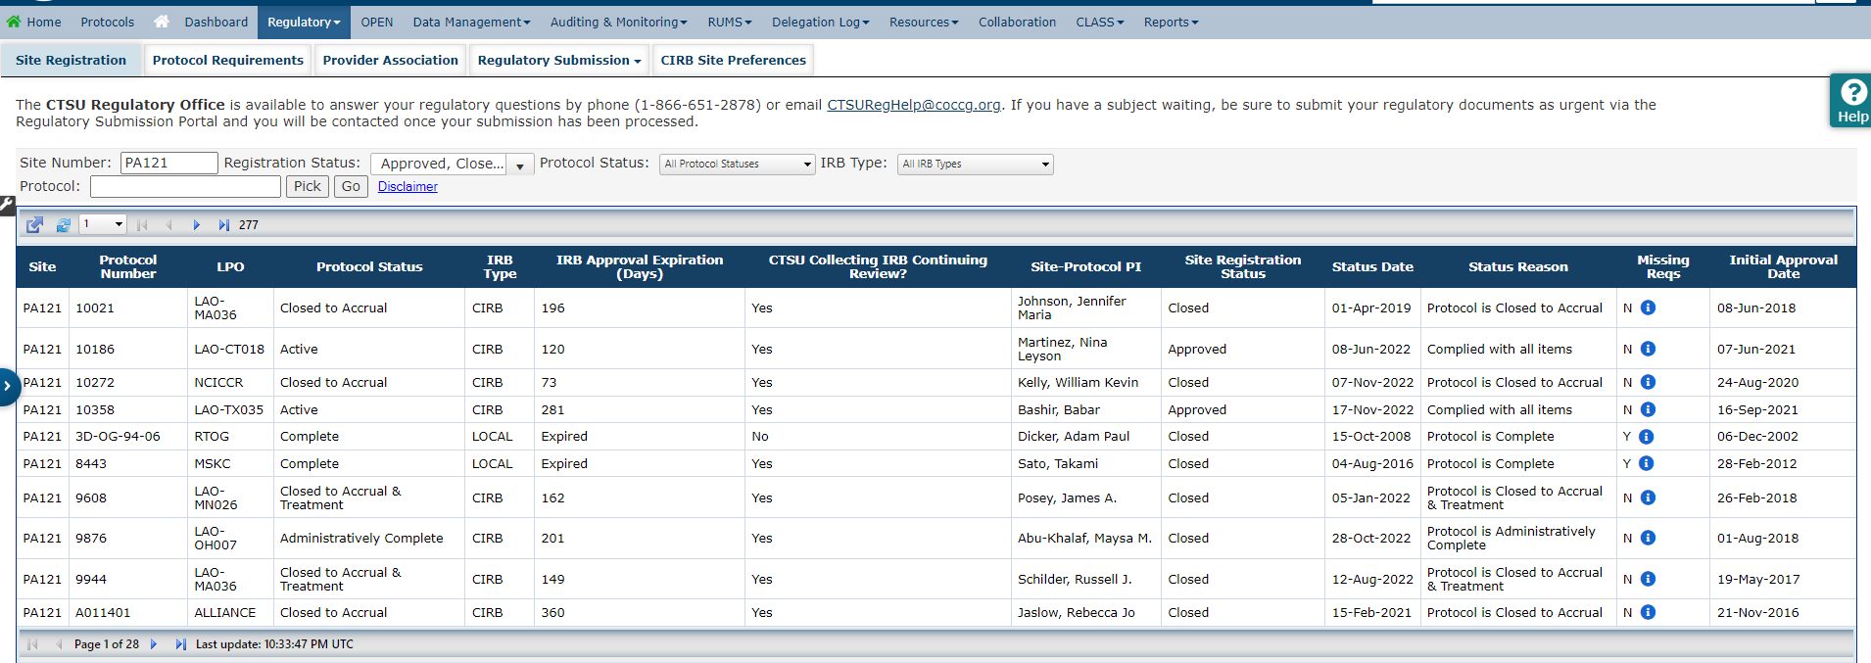
CTSU Website – Site Registration

Slide 25
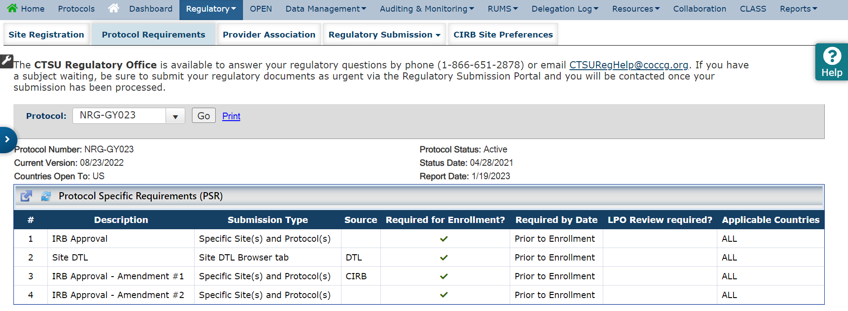
CTSU Website – Protocol Specific Requirements

Slide 26
CTSU Forms
The below CTSU Forms are available on the CTSU website on the Resources tab under CTSU Operation Information
CTSU IRB Certification Form
CTSU Site Addition Form
Optional Form 1 – Withdrawal from Protocol
CTSU Patient Enrollment Transmittal Form
CTSU Patient Transfer Form
CTSU Request for Clinical Brochure Form
CTSU Supply Request Form

Slide 27
CRISP
Individuals interested in receiving automated notification of regulatory changes in the RSS manage subscriptions in the CTSU Report and Information Subscription Portal (CRISP)
Regulatory subscriptions can be utilized by site and LPO users and include, but are not limited to:
IRB Approval Expiring in 30 days
Site Registration Status Changes
Site Registration Approval or Change to Registration Status on Selected Protocols
Packets Received by Protocol
Packets in an LPO Inquiry Status

Slide 28
Regulatory Help Desk
1-866-651-CTSU (2878)
CTSURegHelp@coccg.org
Provides clinical sites and LPO staff the opportunity to speak with CTSU Regulatory Office staff members during business hours to discuss any questions or concerns
Assist sites expedite patient enrollments, referred to as Time of Needs
Regulatory Help Desk staffed 9:00 AM ET to 6:00 PM ET Monday to Friday, except major holidays

Slide 29
Regulatory Help Desk
Continued…
Email for Site Questions: CTSURegHelp@coccg.org
Email for CTEP, DCP, LPO, and other CTSU Stakeholder Questions: CTSURegOffice@coccg.org
Email for Protocol Setup Correspondence: CTSURegSetup@coccg.org
Email for CIRB Signatory Institutions to establish NCI CIRB Site Preferences: CTSURegPref@coccg.org

Slide 30
Thank You!
Questions?
Contact information
Ryan Wilkins
215-789-3651
rwilkin@coccg.org
Amanda Hill
215-789-7030
ahill@coccg.org
Natalie Aftanis
215-789-7033
naftanis@coccg.org

